Slide 1

CS 207: Applied Database Practicum
Week 10
Varun Dutt
School of Computing and Electrical Engineering
School of Humanities and Social Sciences
Indian Institute of Technology Mandi, India
Scaling the Heights
<number>

Slide 2
HTTP server in Node.js
The Node.js framework is mostly used to create server based applications. The framework can easily be used to create web servers which can serve content to users.
There are a variety of modules such as the "http" and "request" module, which helps in processing server related requests in the web server space.
<number>

Slide 3
Node.js as web server using HTTP
So we’ll starting with example-
Our application is going to create a simple server module which will listen on port no 7000. If a request is made through the browser on this port no, then server application will send a 'Hello' World' response to the client.
<number>

Slide 4
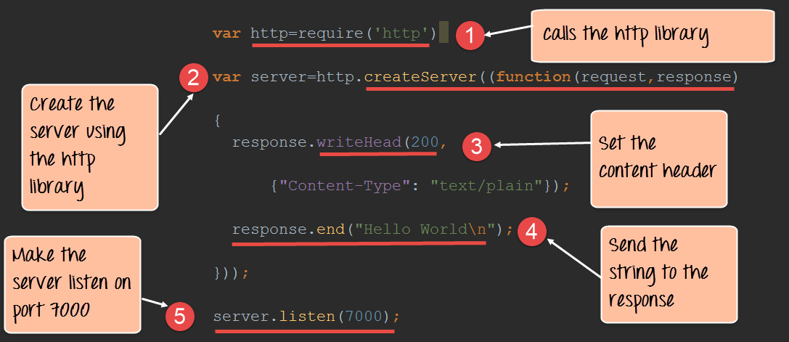
Node as web server
Code -
<number>

Slide 5
Node as web server
Above code explanation -
We use the require function to get the required functions from the http module so that it can be used in our application.
We are creating a server application which is based on a simple function. This function is called whenever a request is made to our server application.
<number>

Slide 6
Node as web server
3. When a request is received, we are saying to send a response with a header type of '200.' This number is the normal response which is sent in an http header when a successful response is sent to the client.
4. In the response itself, we are sending the string 'Hello World.'

Slide 7
Node as web server
5. We are then using the server.listen function to make our server application listen to client requests on port no 7000. You can specify any available port over here.
<number>

Slide 8
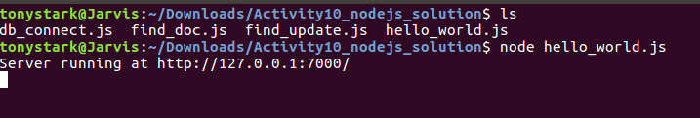
Running a nodejs application
<number>

Slide 9
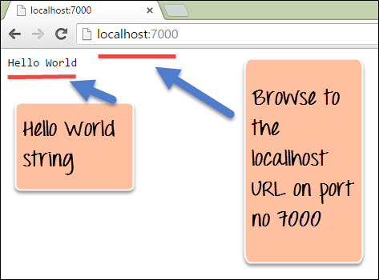
Node as web server
Output -
<number>

Slide 10
Node.js MongoDB Create Database
Creating a database -
To create a database in MongoDB, start by creating a MongoClient object, then specify a connection URL with the correct ip address and the name of the database you want to create.
MongoDB will create the database if it does not exist, and make a connection to it.
<number>

Slide 11
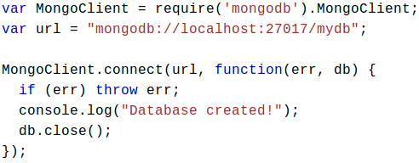
Node.js MongoDB Create Database
Example -
Code -
<number>

Slide 12
Node.js MongoDB Create Database
Run the above code -
node <file_name>.js
Output -
Database created!
In MongoDB, a database is not created until it gets content!
MongoDB waits until you have created a collection (table), with at least one document (record) before it actually creates the database (and collection).
<number>

Slide 13
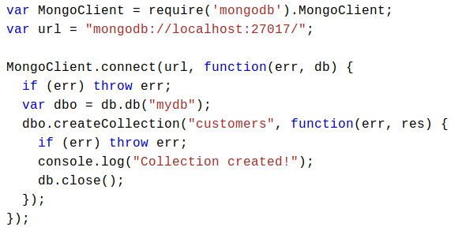
Node.js MongoDB Create Collection
To create a collection in MongoDB, use the
createCollection() method.
Example -
<number>

Slide 14
Node.js MongoDB Create Collection
On running the above code -
Output -
Collection created!
In MongoDB, a collection is not created until it gets content!
MongoDB waits until you have inserted a document before it actually creates the collection.
<number>

Slide 15
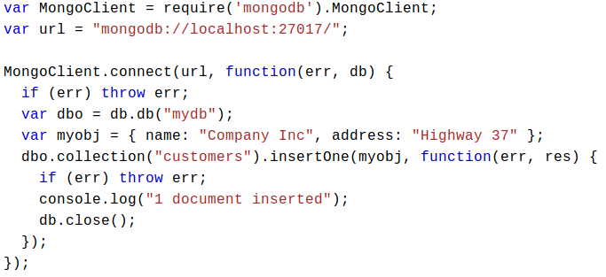
Node.js MongoDB Insert in Collection
Example using insertOne() method-
<number>

Slide 16
Node.js MongoDB Insert in Collection
After running the above code-
Output -
1 document inserted
If you try to insert documents in a collection that do not exist, MongoDB will create the collection automatically.
<number>

Slide 17
Node.js MongoDB Insert in Collection
Example on inserting multiple documents using insertMany() method.
With array of objects, insertMany also takes a callback function where you can work with any errors, or the result of the insertion.
<number>

Slide 18
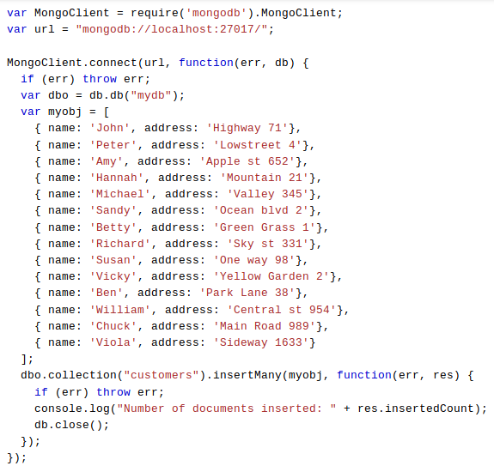
Node.js MongoDB Insert in Collection
<number>

Slide 19
Node.js MongoDB Insert in Collection
Output -
Number of documents inserted: 14
<number>

Slide 20
Node.js MongoDB Delete in Collection
Example using deleteOne() method for deleting one record or document.
If the query finds more than one document, only the first occurrence is deleted.
<number>

Slide 21
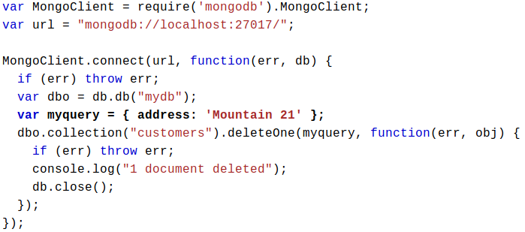
Node.js MongoDB Delete in Collection
<number>

Slide 22
Node.js MongoDB Delete in Collection
Output -
1 record deleted
Similar to insertion case, in delete case too we have deleteMany() method to delete more than one document.
<number>

Slide 23
Node.js MongoDB Update in Collection
Example on update document -
Update a record or document using updateOne() method.
If the query finds more than one record, only the first occurrence is updated.
<number>

Slide 24
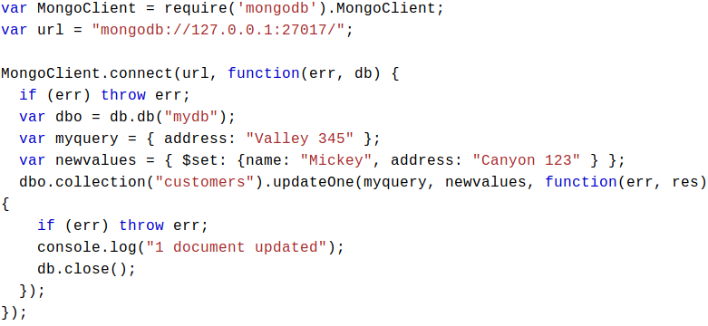
Node.js MongoDB Update in Collection
Example -
<number>

Slide 25
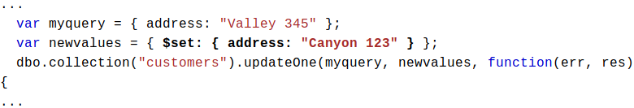
Node.js MongoDB Update in Collection
Output -
1 document updated
Update only specific fields -
When using the $set operator, only the specified fields are updated:
<number>

Slide 26
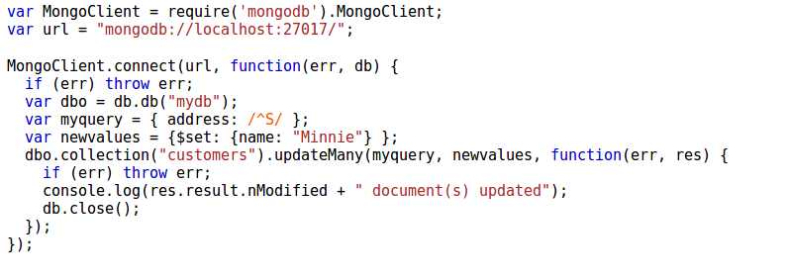
Node.js MongoDB Update in Collection
Likewise in insertion, update too has updateMany() method to update multiple documents.
<number>

Slide 27
What is AJAX?
AJAX stands for Asynchronous Javascript And XML.
AJAX is not a programming language.
AJAX is a way of using existing standards (JavaScript and XML) to make more interactive web applications.
AJAX was popularized in 2005 by Google (with Google suggest)
<number>

Slide 28
How AJAX Works?
An event occurs in a web page (the page is loaded, a button is clicked).
2. An XMLHttpRequest object is created by JavaScript.
3. The XMLHttpRequest object sends a request to a Web Server.
4. The server processes the request.
5. The server sends a response back to the web page.
6. The response is read by JavaScript.
7. Proper action (like page update) is performed by JavaScript.
<number>

Slide 29
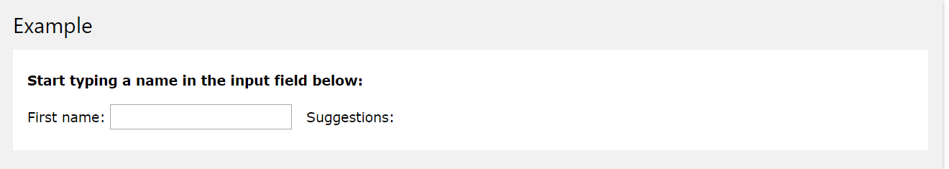
AJAX PHP
AJAX is used with PHP to create more interactive applications.
The following example demonstrates how a web page can communicate with a web server while a user types characters in an input field:
In the example above, when a user types a character in the input field, a function called "showHint()" is executed.
The function is triggered by the onkeyup event.
<number>

Slide 30
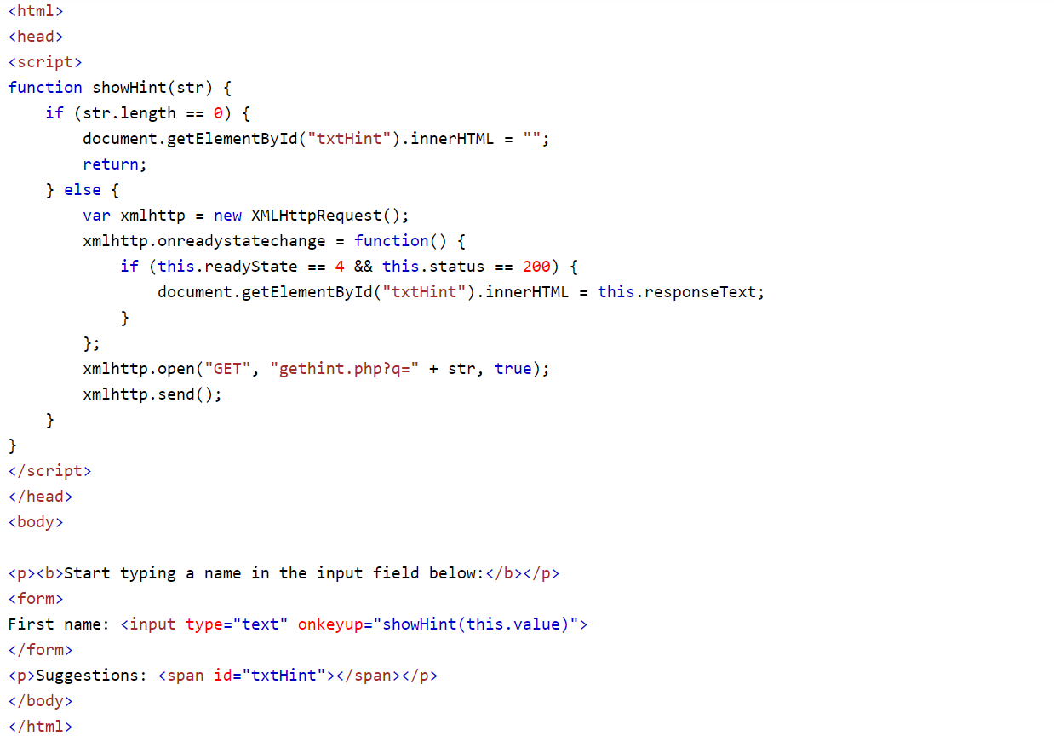
AJAX PHP code
<number>

Slide 31
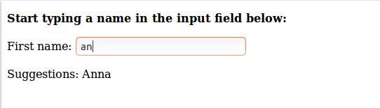
AJAX PHP output
<number>

Slide 32
Summary
An AJAX transaction involves the client sending an asynchronous HTTP request and the server responding with XML
– The client processes the resulting XML document tree
AJAX applications run entirely on the client except when they need to access data on the server – Can treat the server as a database/file system.
Well-written AJAX applications, running with a fast Internet connection, can be as nice to use as traditional applications (or nicer).
<number>

Slide 33
REFERENCES
http://cglab.ca/~morin/teaching/2405/notes/ajax1.pdf
https://www.w3schools.com
Acknowledgements: Thank you to Suryavanshi Virendrasingh, Shashwat Garg, Aman Khandelwal and Abhinav Choudhury for their help with the lecture, activity and assignment materials for this week.
<number>

